Slide 1
Language Models
Chien Chin Chen

Slide 2
Language Modeling (1/10)
Model the way of language speaking.
Try to model the sequence of word usage of a certain language.
Given M_{國}, M_{台}, M_{粵}
他給我打
他打我
他打我來的
For any language model … how can we calculate probabilities over word sequences – P(w₁w₂w₃w₄)?
→ P(S|M_{國}) P(S|M_{台}) P(S|M_{港})
→ P(S|M_{國}) P(S|M_{台}) P(S|M_{港})
→ P(S|M_{國}) P(S|M_{台}) P(S|M_{港})

Slide 3
Language Modeling (2/10)
We can always use the chain rule to decompose the probability:
P(w₁w₂w₃w₄) = P(w₁)P(w₂|w₁)P(w₃|w₁w₂)P(w₄|w₁w₂w₃)
Briefly, the task of language modeling is to predict (model) the next word given the previous words:
P(w_{n}|w₁,…,w_{n-1})
Language modeling is a classic NLP problem.
It is fundamental to speech recognition, machine translation, chatting …
Sue swallowed the large green ____.
This task has been well-studied, and many estimation methods were developed for this problem.
history
pill
people

Slide 4
Language Modeling (3/10)
Markov assumption:
To give reasonable predictions, only the prior local context (the last few words) affects the next word.
If all histories have the same last n – 1 words, then we have an (n – 1)^{th} order Markov model or an n-gram word model.
E.g., bi-gram: P(w_{n}|w_{n-1}), tri-gram: P(w_{n}|w_{n-1}w_{n-2}).
Bi-gram: P(w₁w₂w₃w₄) = P(w₁)P(w₂|w₁)P(w₃|w₂)P(w₄|w₃)
The simplest form of language model simply throws away all conditioning context, and estimates each word independently.
P(w₁w₂w₃w₄) = P(w₁)P(w₂)P(w₃)P(w₄)
Such a model is also called a unigram language model.

Slide 5
Language Modeling (4/10)
In principle, we would like the n of our n-gram models to be fairly large.
Sue swallowed the large green ____.
But there will be a problem if we consider a long textual history.
The model parameters will be too many to estimate!!!
If we assume that our language vocabulary consists of 20,000 words.
For this reason, n-gram systems usually use bi-gram or tri-grams.
pill
tree
Model | Parameters
Bi-gram | 20,000 x 19,999 = 400 million
Tri-gram | 20,000² x 19,999 = 8 trillion
Four-gram | 20,000³ x 19,999 = 1.6 x 10¹⁷
Difficult to have a large corpus to
produce reliable parameter estimation.

Slide 6
Language Modeling (5/10)
But … How can we build n-gram model?
Or, how can we acquire P(w_{n}|w₁,…,w_{n-1})?
We can infer the probability from text (training) corpus.
If Kong is always followed by Hong in corpus …
We should assign P(Kong|Hong) a high probability and give P(*|Hong) a small value.

Slide 7
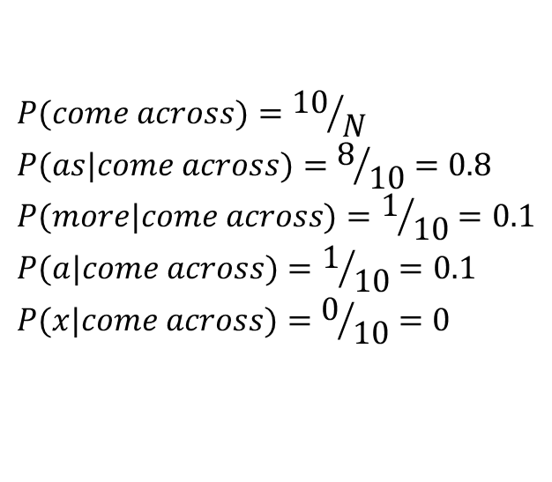
Language Modeling (6/10)
In this training corpus …
We found 10 training instances of the words comes across,
And of those, 8 times they were followed by as,
Once by more,
Once by a.
Then …
$$P(come across)={10}/N \\ P(as|come across)=8/{10}=0.8 \\ P(more|come across)=1/{10}=0.1 \\ P(a|come across)=1/{10}=0.1 \\ P(x|come across)=0/{10}=0$$
for x not among
the above words

Slide 8
Language Modeling (7/10)
Relative frequency is also called the maximum likelihood estimate (MLE).
It makes the probability of observed events as high as it can.
MLE is unsuitable for statistical inference in NLP.
The sparseness of data would cause a zero probability of uncommon events.
Then, the probability of a long string will be zero because of zero propagation.
P(w₁w₂w₃w₄) =
P(w₁|dummy,dummy)P(w₂|dummy,w₁)P(w₃|w₁,w₂)P(w₄|w₂,w₃)
= 0!!
0.8
0.75
0.85
0
bcz no such a training instance in the corpus!!

Slide 9
Language Modeling (8/10)
The problem of data sparseness is unavoidable!!
After training on 1.5 million words from the IBM Laser Patent Text corpus …
Bahl et al. (1983) report that 23% of the trigram tokens found in further test data drawn from the same corpus were previously unseen.
One might hope that by collecting much more data that the problem of data sparseness would go away.
Maybe … but it is never a general solution to the problem.
You can never have a corpus that is large enough to cover everything.
E.g., comes across could be followed by any (infinite) number.

Slide 10
Language Modeling (9/10)
The evaluated sentence “in person she was inferior to both sisters”
In person | she |  | was |  | inferior |  | to |  | both |  | sisters
1-gram | P(.) |  | P(.) |  | P(.) |  | P(.) |  | P(.) |  | P(.)
 | she | 0.011 | was | 0.015 | inferior | 0.00005 | to | 0.032 | both | 0.0005 | sisters | 0.0003
P(S|1-gram) = 3.96x10⁻¹⁷
In person | she |  | was |  | inferior |  | to |  | both |  | sisters
2-gram | P(.|person) |  | P(.|she) |  | P(.|was) |  | P(.|inferior) |  | P(.|to) |  | P(.|both)
 | she | 0.009 | was | 0.122 | inferior | 0 | to | 0.212 | both | 0.0004 | sisters | 0.006
P(S|2-gram) = 0
In person | she |  | was |  | inferior |  | to |  | both |  | sisters
3-gram | P(.|in person) |  | P(.|person she) |  | P(.|she was) |  | P(.|was inferior) |  | P(.|inferior to) |  | P(.|to both)
 | unseen |  | was | 0.5 | Inferior | 0 | unseen |  | both | 0 | sisters | 0
P(S|2-gram) = 0

Slide 11
Language Modeling (10/10)
Discounting – a better way to overcome data sparseness.
To decrease the probability of previously seen events.
So there is a little bit of probability mass left over for previously unseen events.
Is also referred to as smoothing.
Presumably because a distribution without zeros is smoother than one with zeros.
We introduce three smoothing methods:
Laplace’s law, Lidstone’s law, and Witten-Bell smoothing

Slide 12
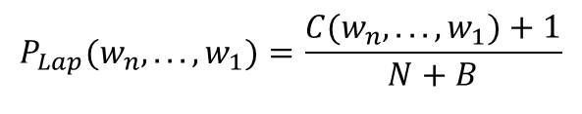
Laplace’s Law (1/3)
In Laplace’s law:
Also referred to as adding one smoothing.
Examples in Church and Gale (1991).
Estimate bi-gram.
The corpus of 44 million (4.4 x 10⁷) words.
Half for training (2.2 x 10⁷ words).
Half for testing (2.2 x 10⁷ words).
Vocabulary of 400,653 words.
B =
P_{Lap}(unseen bi-gram) = (0+1) / (2.2x10⁷ + 1.6x10¹¹) = 6.2x10⁻¹².
$$P_{Lap}(w_{n},...,w_{1})=\frac{C(w_{n},...,w_{1})+1}{N+B}$$
normalization factor,
number of possible n-grams.
400,653 x 400,653 = 1.6 x 10¹¹ possible bi-grams.

Slide 13
Laplace’s Law (2/3)
The problem of Laplace’s law:
When B >> N, Laplace’s law would give to much of the probability to unseen events.
For an bi-gram x that never appears in the training corpus,
P_{MLE}(x) = 0/2.2x10⁷=0
P_{Lap}(x) = (0+1) / (2.2x10⁷ + 1.6x10¹¹) = 6.2x10⁻¹²
The expected frequency f_{Lap} = P_{Lap} x N = 6.2x10⁻¹² x 2.2x10⁷ = 0.000137.
For an bi-gram x that appears once in the training corpus,
P_{MLE}(x) = 1/2.2x10⁷=4.5x10⁻⁸
P_{Lap}(x) = (1+1) / (2.2x10⁷ + 1.6x10¹¹) = 1.25x10⁻¹¹
The expected frequency f_{Lap} = P_{Lap} x N = 1.25x10⁻¹¹ x 2.2x10⁷ = 0.000274.
the difference
between MLE
and LAP may
be ignored!!

Slide 14
Laplace’s Law (3/3)
In the training part, 74,671,100,000 bi-grams are unseen bi-grams.
So 74,671,100,000 x 6.2x10⁻¹² = 46.5% of the probability space has been given to unseen bigrams.
But … the authors found that only 9.2% of the bi-grams in further text were previously unseen.
The discounting of Lapalce’s law from seen events is far too much.
r | f_{Lap}
0 | 0.000137
1 | 0.000274
2 | 0.000411
3 | 0.000548
4 | 0.000685

Slide 15
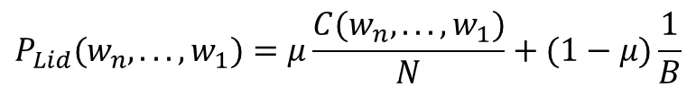
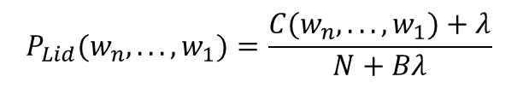
Lidstone’s Law (1/2)
To overcome the overestimate of Laplace’s law, we add not one, but some (normally smaller) positive value λ:
The method has been showed as a linear interpolation between the MLE estimate and a uniform prior.
where μ=N/(N+Bλ).
$$P_{Lid}(w_{n},...,w_{1})=\frac{C(w_{n},...,w_{1})+λ}{N+Bλ}$$
$$P_{Lid}(w_{n},...,w_{1})=μ\frac{C(w_{n},...,w_{1})}{N}+(1−μ)\frac{1}{B}$$

Slide 16
Lidstone’s Law (2/2)
The most widely used value for λ is 0.5.
This method has its own names, the Jeffreys-Perks Law.
In practice, Lidstone’s law often helps.
To avoid too much of the probability space being given to unseen events (by choosing a small λ).
But … we need a good way to guess an appropriate value for λ.

Slide 17
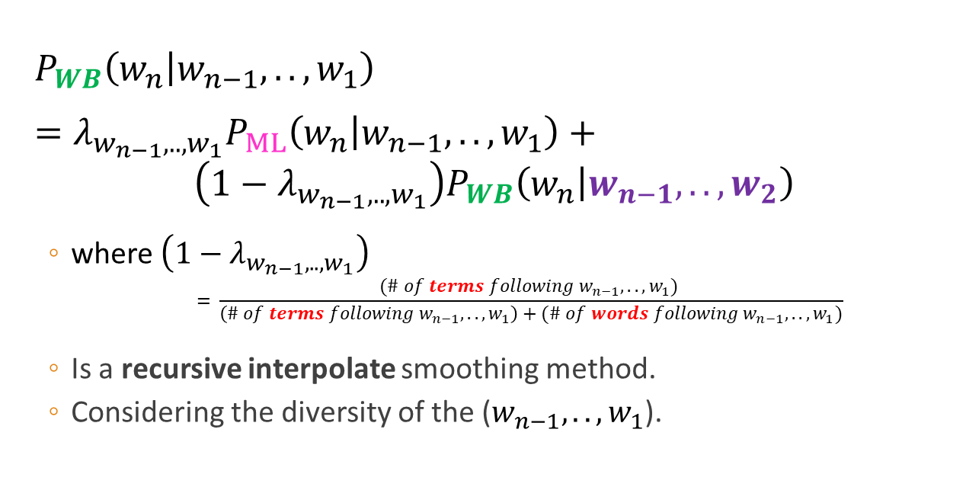
Witten-Bell Smoothing (1/2)
$P_{WB}\left(w_{n} | w_{n−1},..,w_{1}\right)$
$=λ_{w_{n−1},..,w_{1}}P_{ML}\left(w_{n} | w_{n−1},..,w_{1}\right)+$
$$\left(1−λ_{w_{n−1},..,w_{1}}\right)P_{WB}\left(w_{n} | w_{n−1},..,w_{2}\right)$$
where $\left(1−λ_{w_{n−1},..,w_{1}}\right)$
$$= \frac{(\# of terms following{ w}_{n−1},..,w_{1}) }{\left(\# of terms following{ w}_{n−1},..,w_{1}\right)+(\# of words following{ w}_{n−1},..,w_{1})}$$
Is a recursive interpolate smoothing method.
Considering the diversity of the ($w_{n−1},..,w_{1}$).

Slide 18
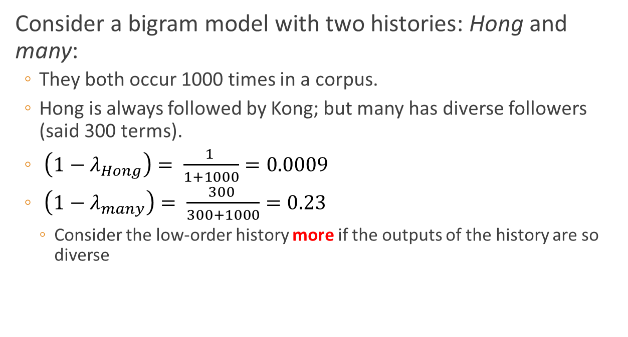
Witten-Bell Smoothing (2/2)
Consider a bigram model with two histories: Hong and many:
They both occur 1000 times in a corpus.
Hong is always followed by Kong; but many has diverse followers (said 300 terms).
$\left(1−λ_{Hong}\right)= \frac{1 }{1+1000}=0.0009$
$\left(1−λ_{many}\right)= \frac{300 }{300+1000}=0.23$
Consider the low-order history more if the outputs of the history are so diverse

Slide 19
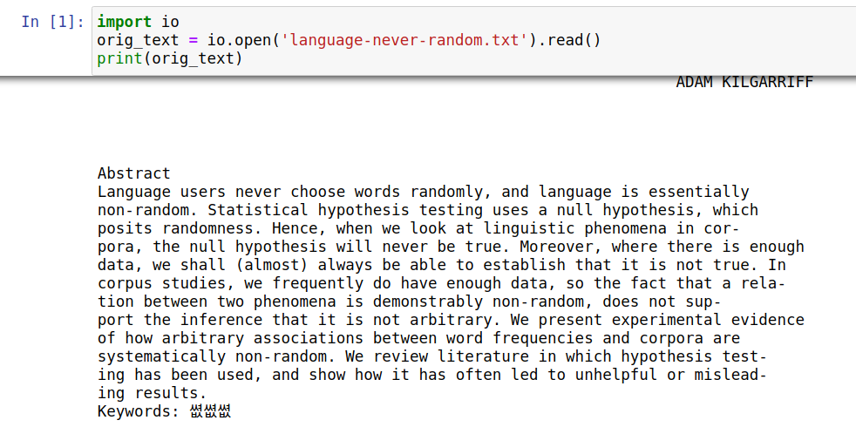
Let’s Practice (1/7)

Slide 20
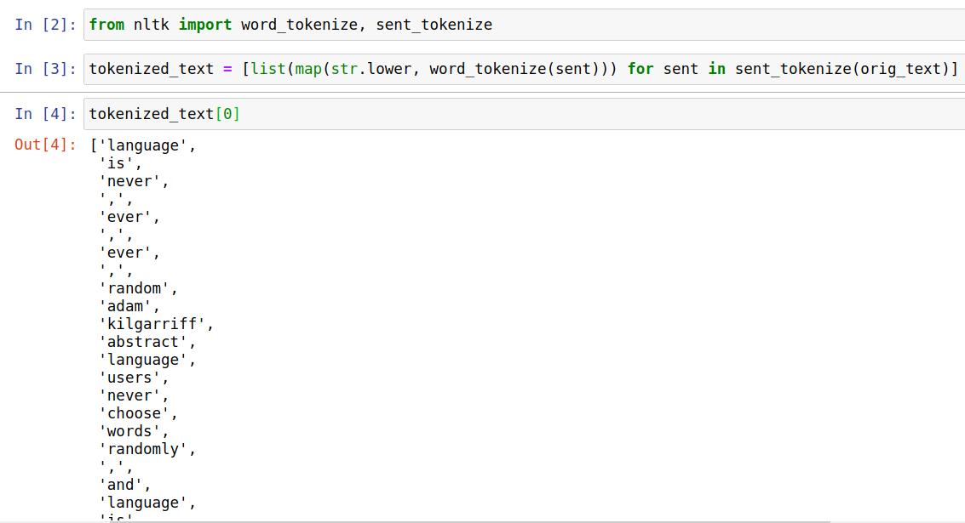
Let’s Practice (2/7)

Slide 21
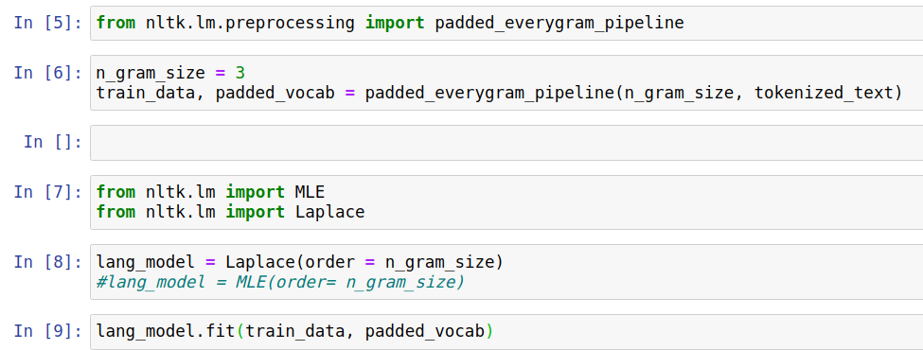
Let’s Practice (3/7)

Slide 22
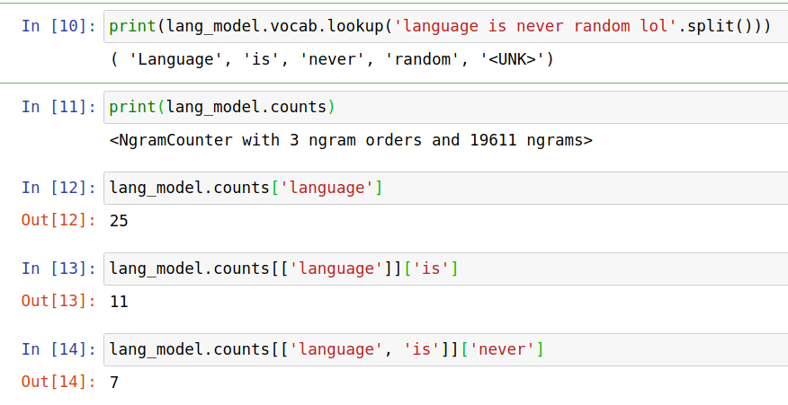
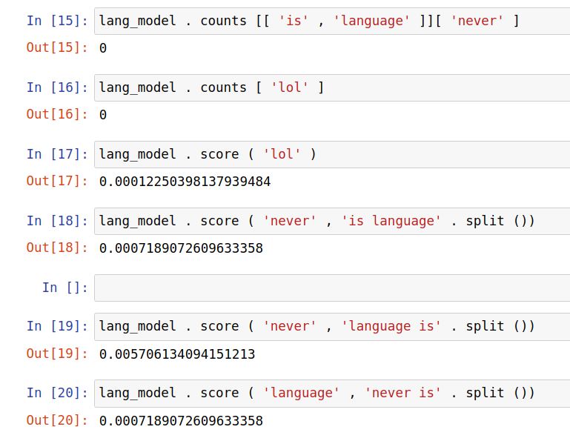
Let’s Practice (4/7)
probability

Slide 23
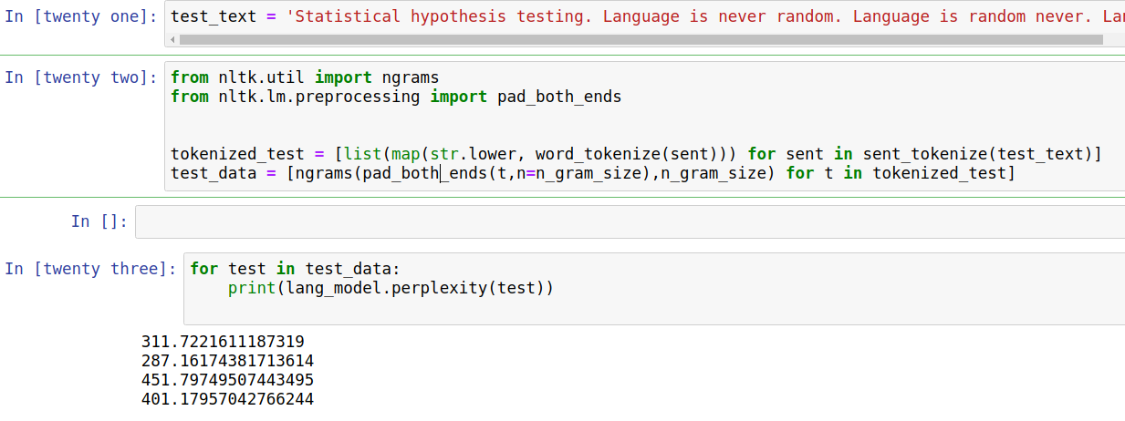
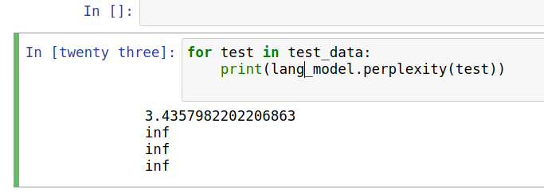
Let’s Practice (5/7)
Four sentences: Statistical hypothesis testing. Language is never random. Language is random never. Language is never random lol.
The outputs from MLE model!!
$perplexity\left(w_{1}w_{2}…w_{N}\right)=2^{−\frac{1}{N}\log_{2}P(w_{1}w_{2}…w_{N})}$
The smaller, the better

Slide 24
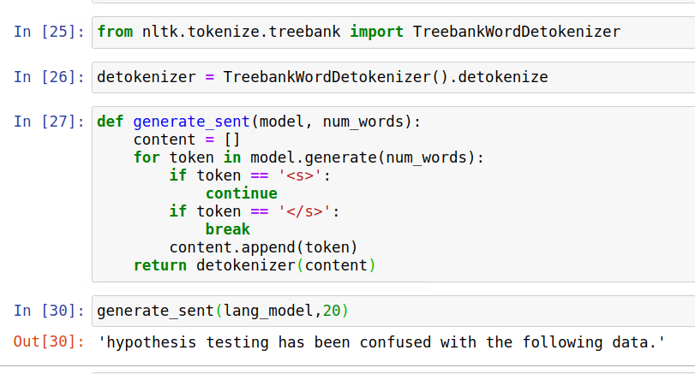
Let’s Practice (6/7)
Let the language model say something ☺

Slide 25
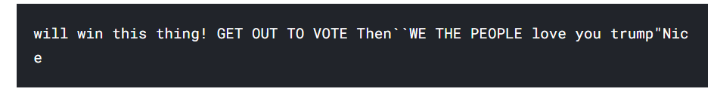

Let’s Practice (7/7)
Funny example – Let’s talk like Trump
https://www.kaggle.com/alvations/n-gram-language-model-with-nltk/
More than 7,000 tweets of Donald Trump

